Slide 1
George Pacheco Evolutionary Biologist
Academic Memoir *
28 August 2022
Oslo, Norway
* Not really.

Slide 2
Agenda
Early Scientific Inclinations & Initial Education
Previous Projects (MSc & PhD | University of Copenhagen)
Parallel Collaborations
Current Projects (Postdoc | Technical University of Denmark)

Slide 3
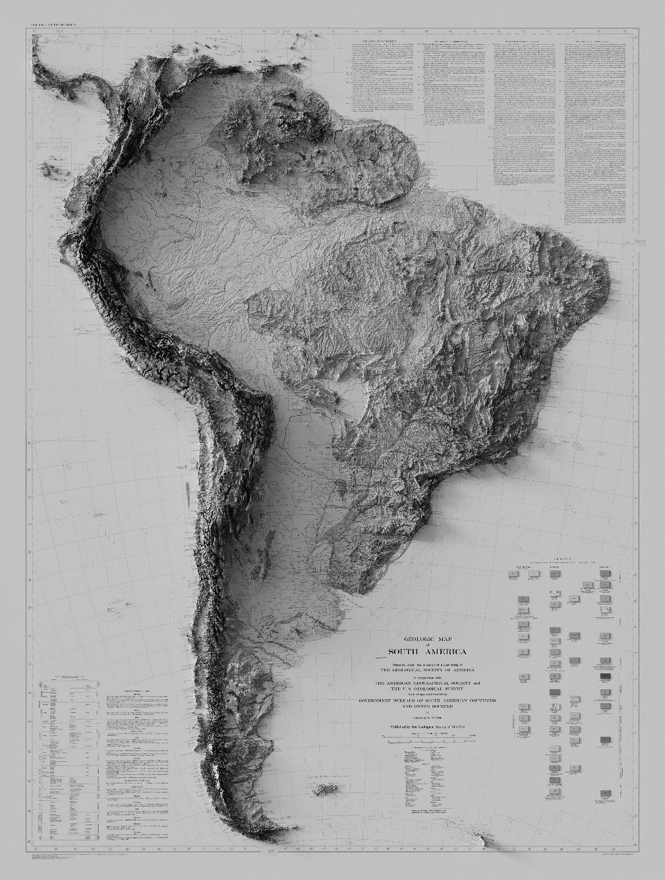
Early Scientific Inclinations & Initial Education

Slide 4
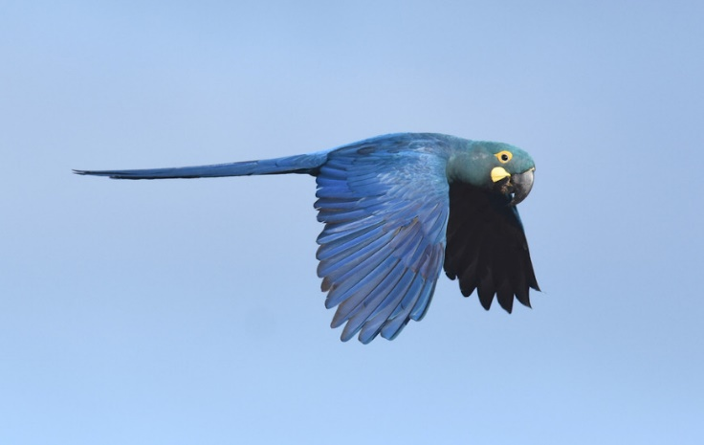
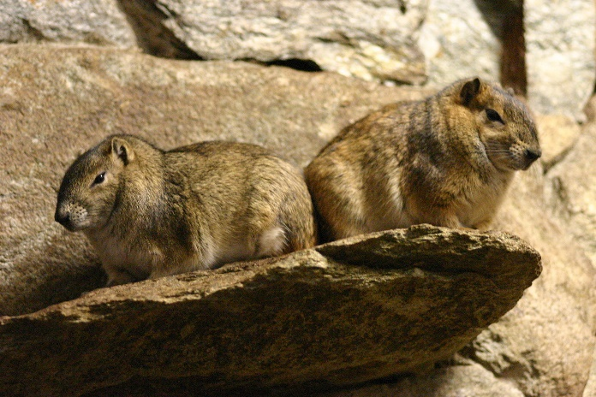
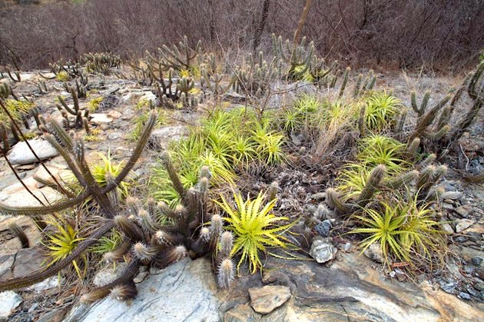
Early Scientific Inclinations & Initial Education

Slide 5
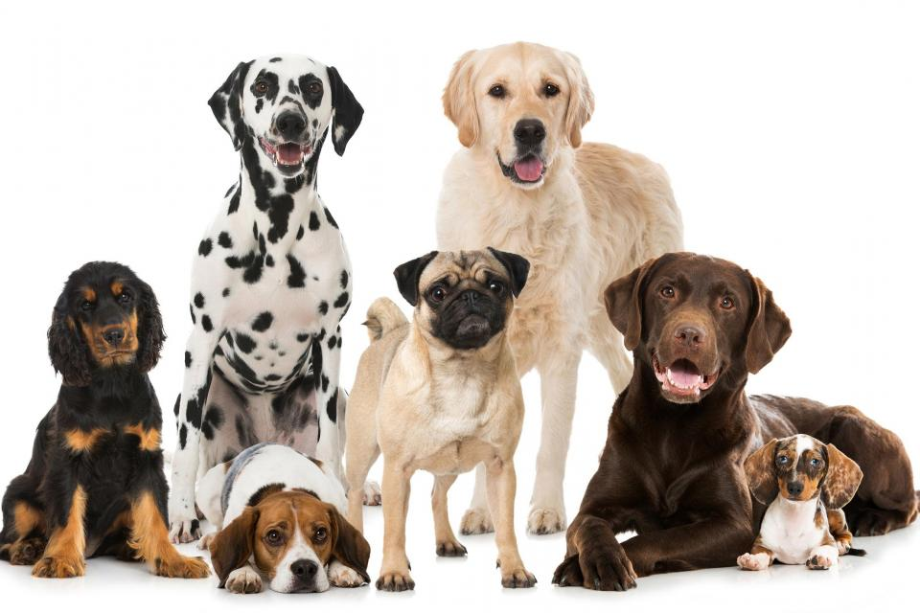
Early Scientific Inclinations & Initial Education

Slide 6
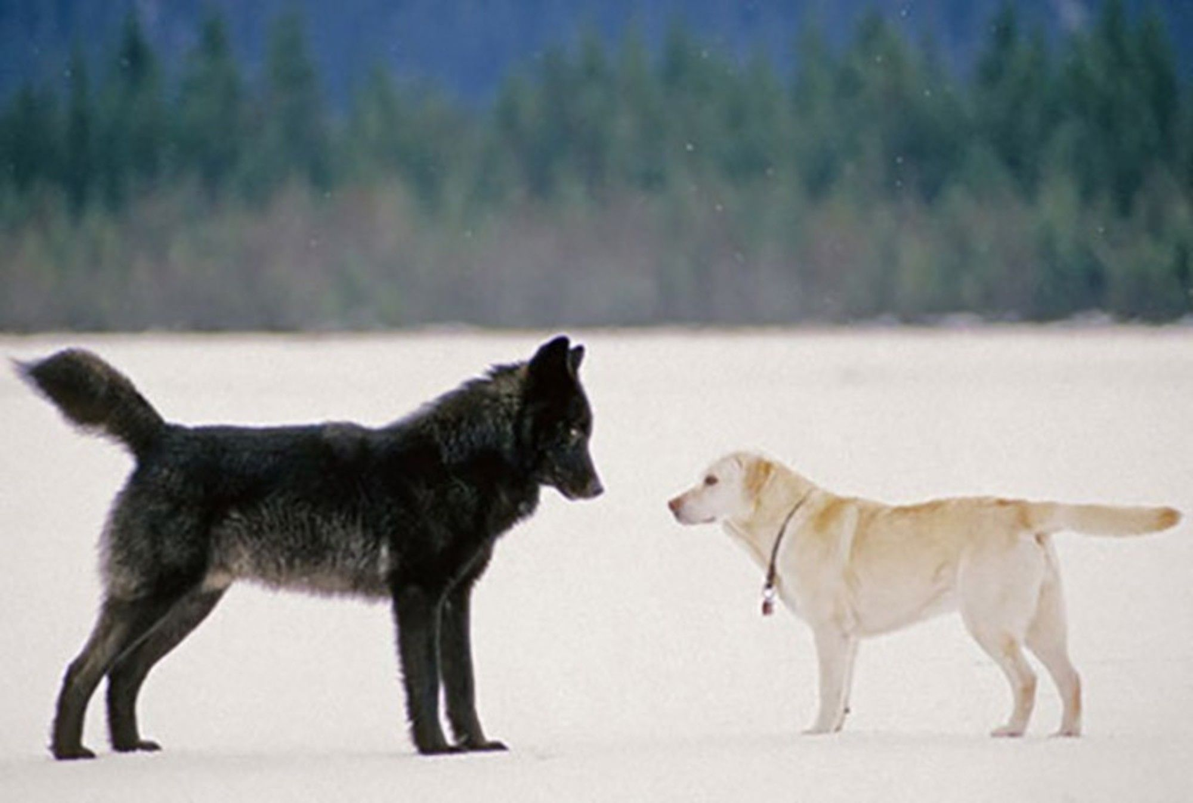
Early Scientific Inclinations & Initial Education

Slide 7
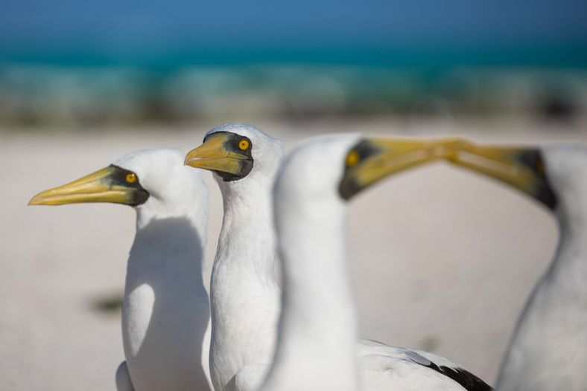
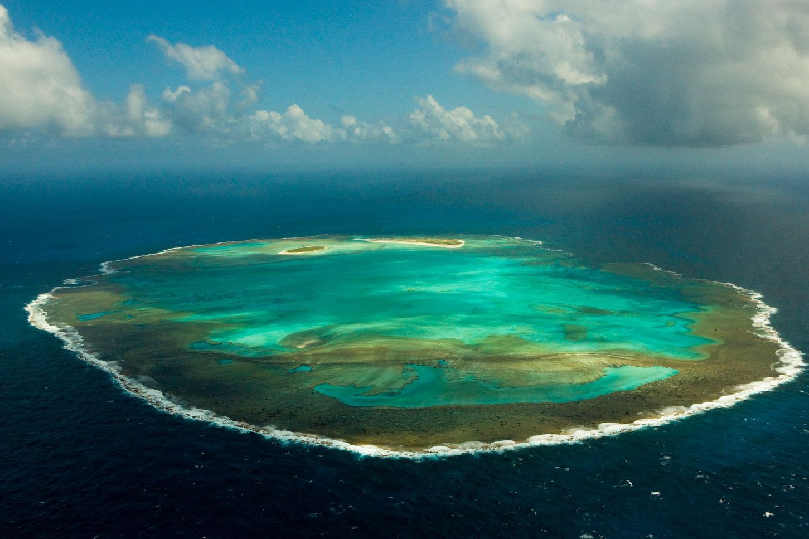
Early Scientific Inclinations & Initial Education
BSc in Biological Sciences
Rocas Atoll

Slide 8



Specialised Education | Genomics of Pigeons
MSc in Biology Danish Government Scholarship
PhD in Evolutionary Genomics Brazilian Science without Borders Scholarship

Slide 9
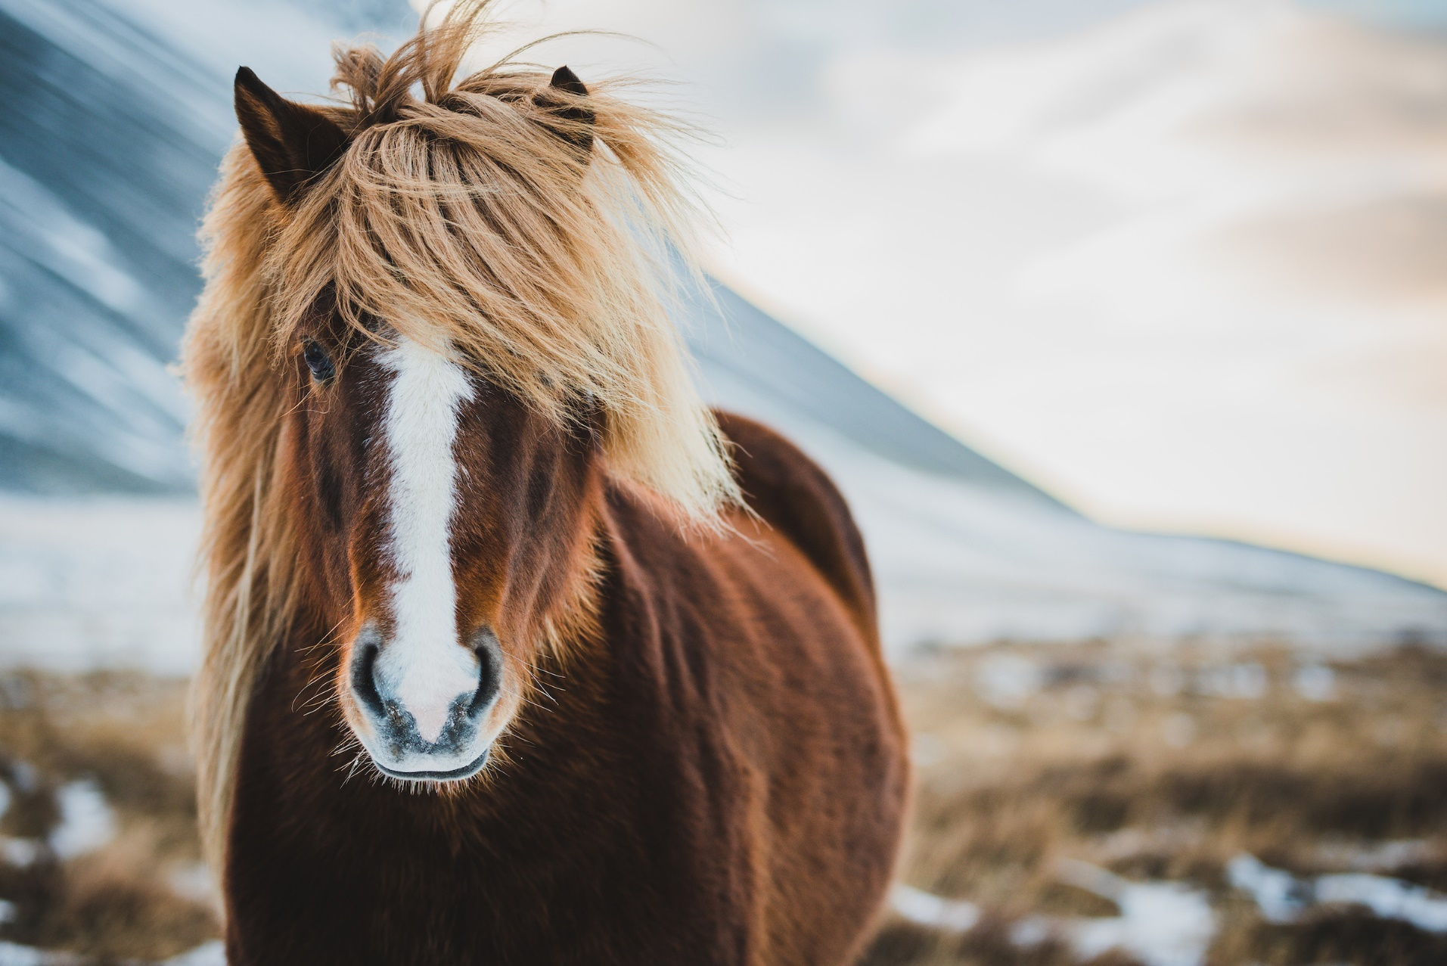
Specialised Education | Genomics of Pigeons

Slide 10

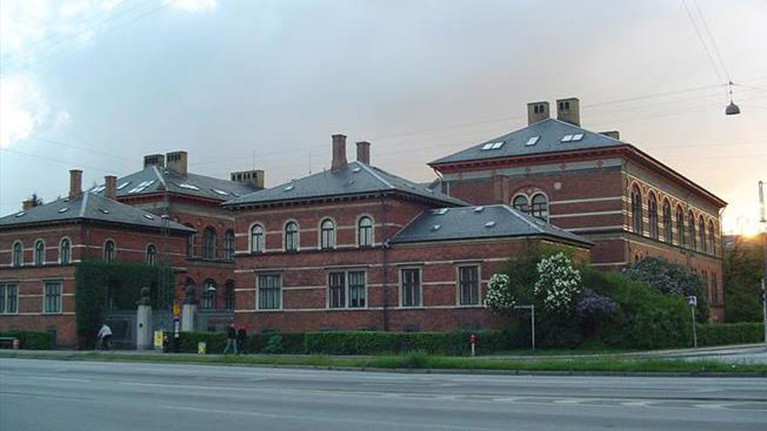
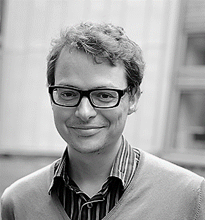
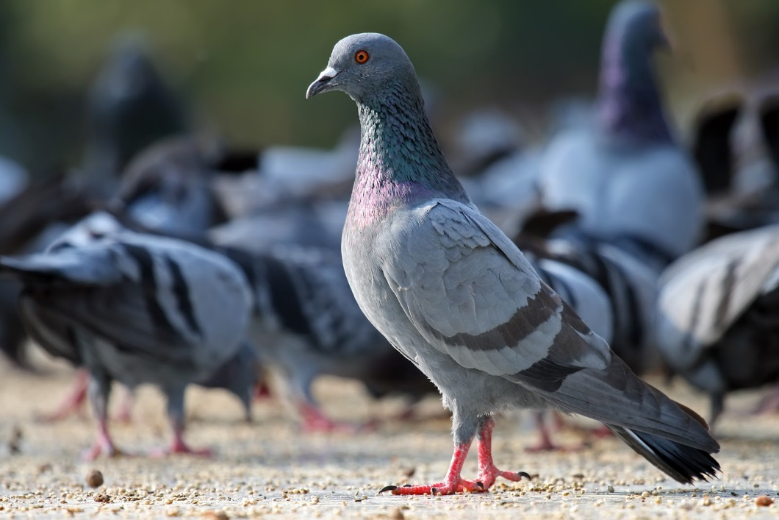
Specialised Education | Genomics of Pigeons
Natural History Museum of Denmark
Section for Evolutionary Genomics
Professor Thomas Gilbert
Domestication of Pigeons

Slide 11
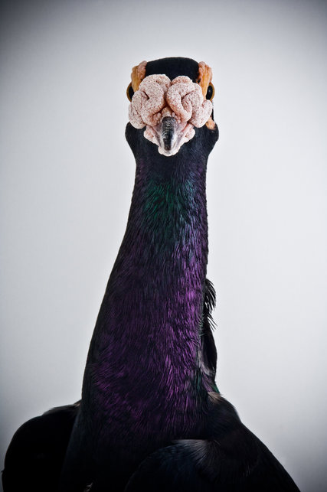
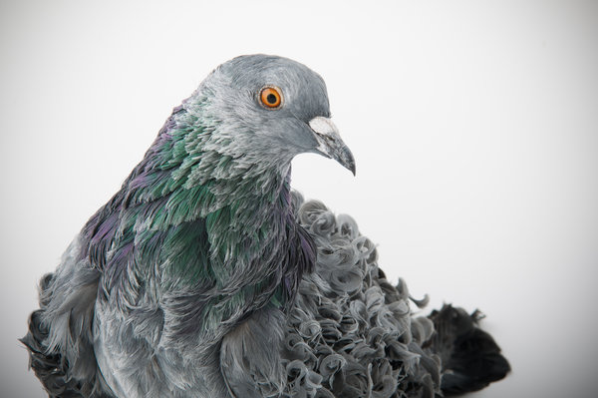
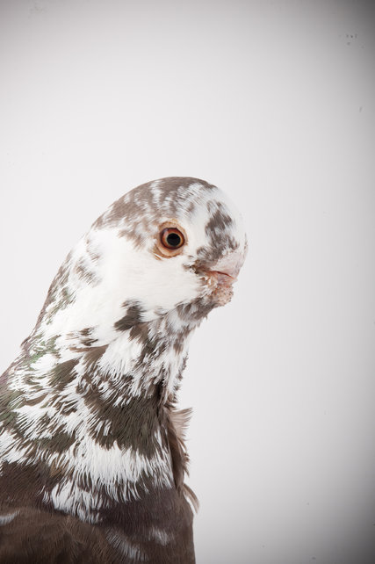
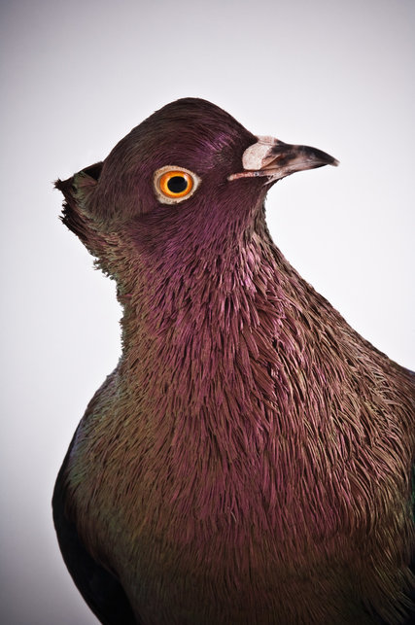
Specialised Education | Genomics of Pigeons

Slide 12
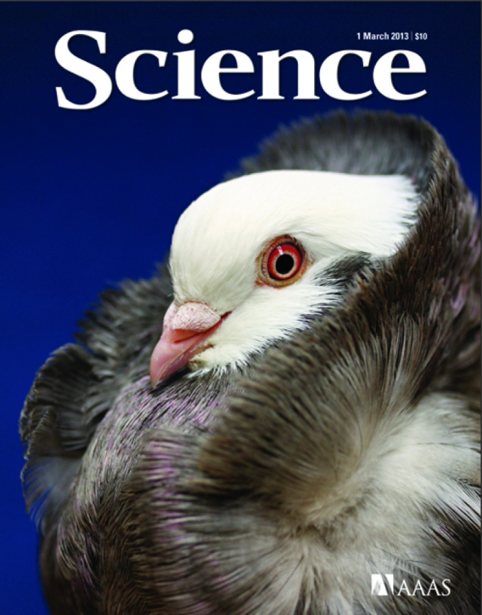
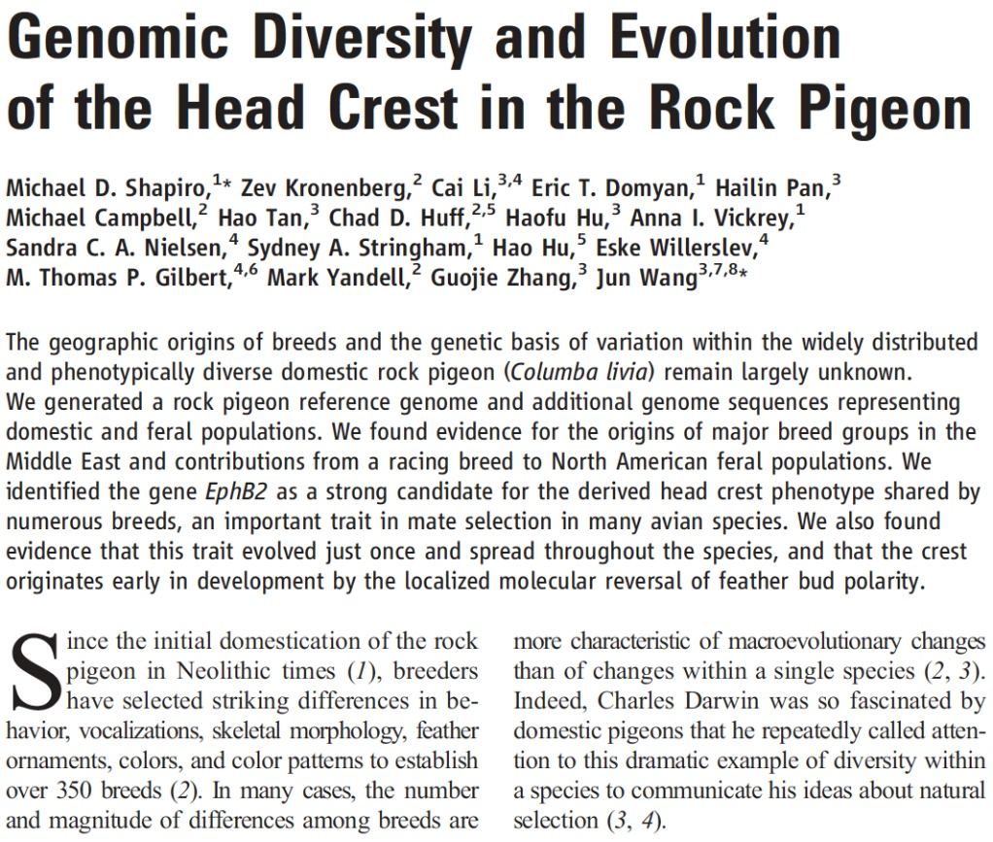
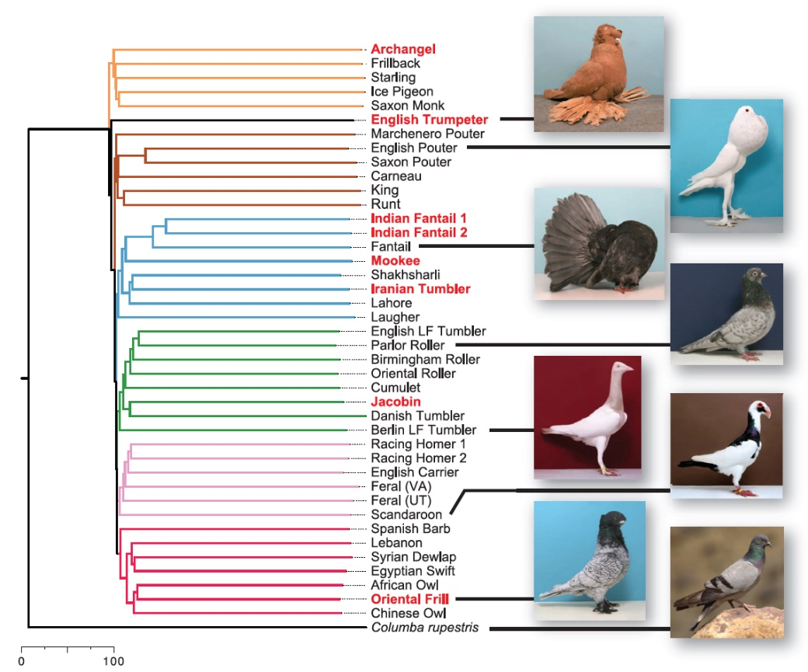
Specialised Education | Genomics of Pigeons

Slide 13
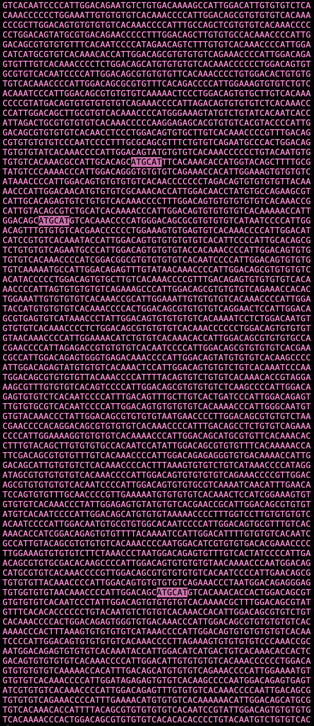
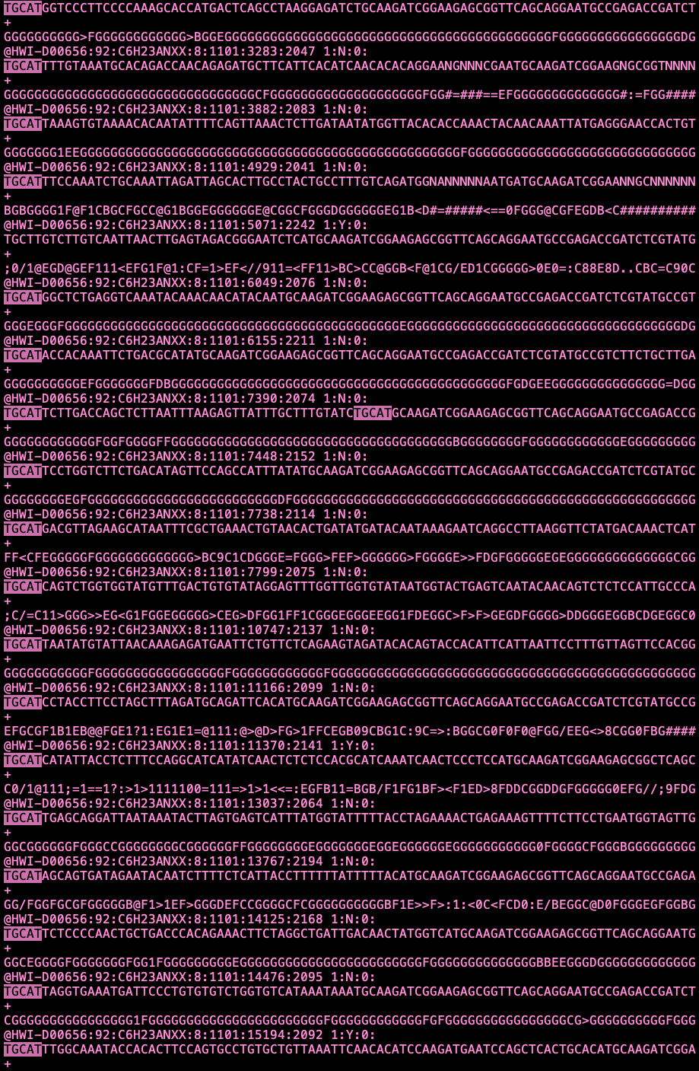
Specialised Education | Genomics of Pigeons
GBSing
(EcoT22I)

Slide 14
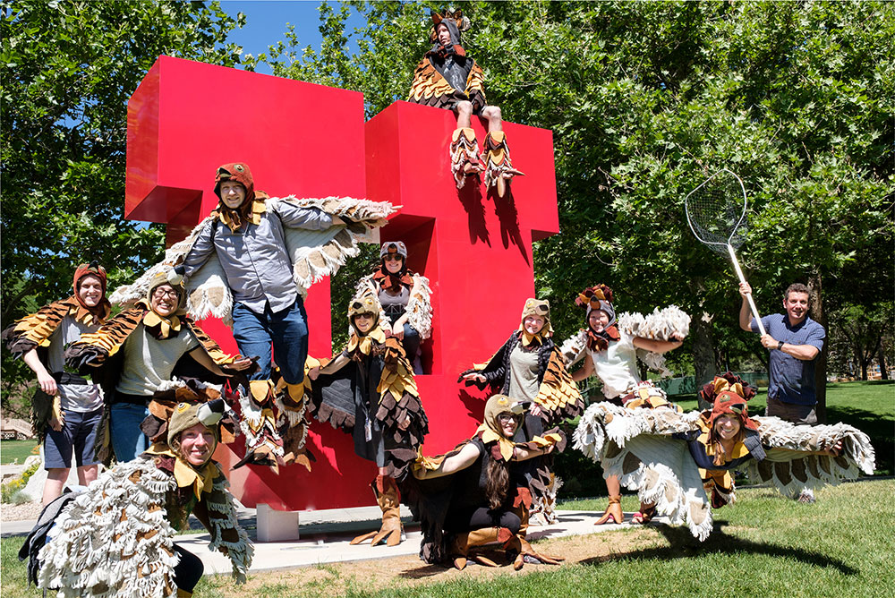
Specialised Education | Genomics of Pigeons
Research Visit for 1 month
+ 200 samples processed Mike Shapiro’s Lab University of Utah

Slide 15


Specialised Education | Genomics of Pigeons
190 GBS Samples
(Our Study)
50 WGS Samples
(Shapiro et al., 2013; Domyan et al., 2016; Gazda et al., 2018)
A Robust, Simple Genotyping-by-Sequencing (GBS) Approach for High Diversity Species
PlosOne | Vol. 8, Issue 5 (2013)
Elshire et al.
Stacks: Building and Genotyping Loci De Novo from Short-read Sequences
G3: Genes, Genomes, Genetics | Vol. 1, Issue 3, pp. 171-182 (2011)
Catchen et al.

Slide 16
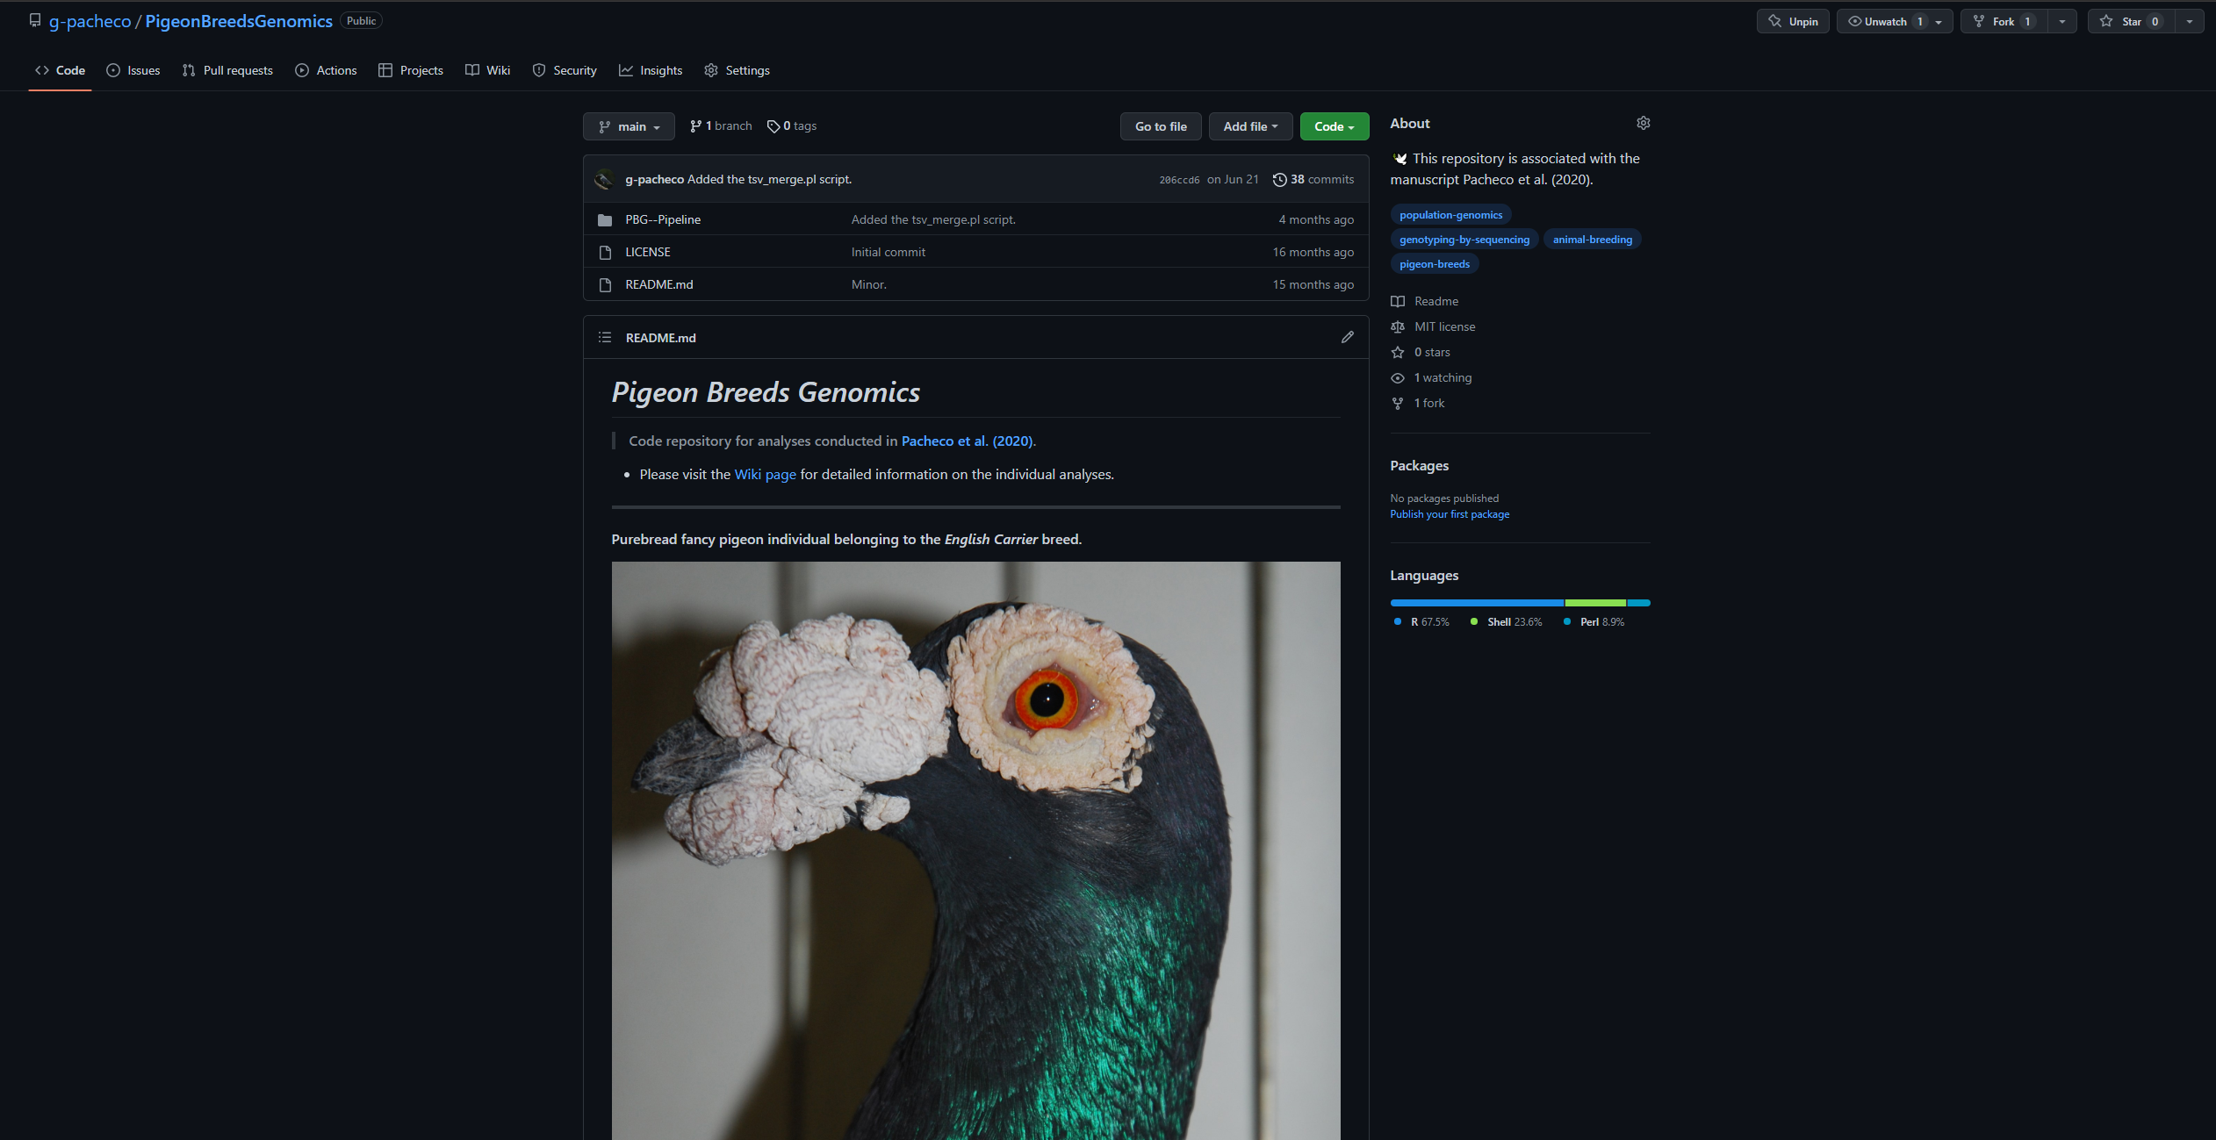
Specialised Education | Genomics of Pigeons

Slide 17
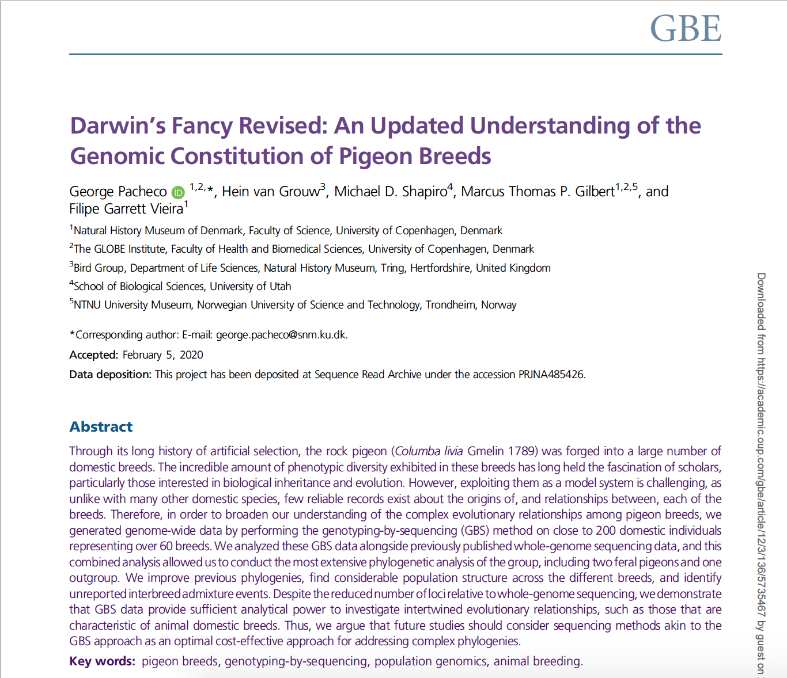
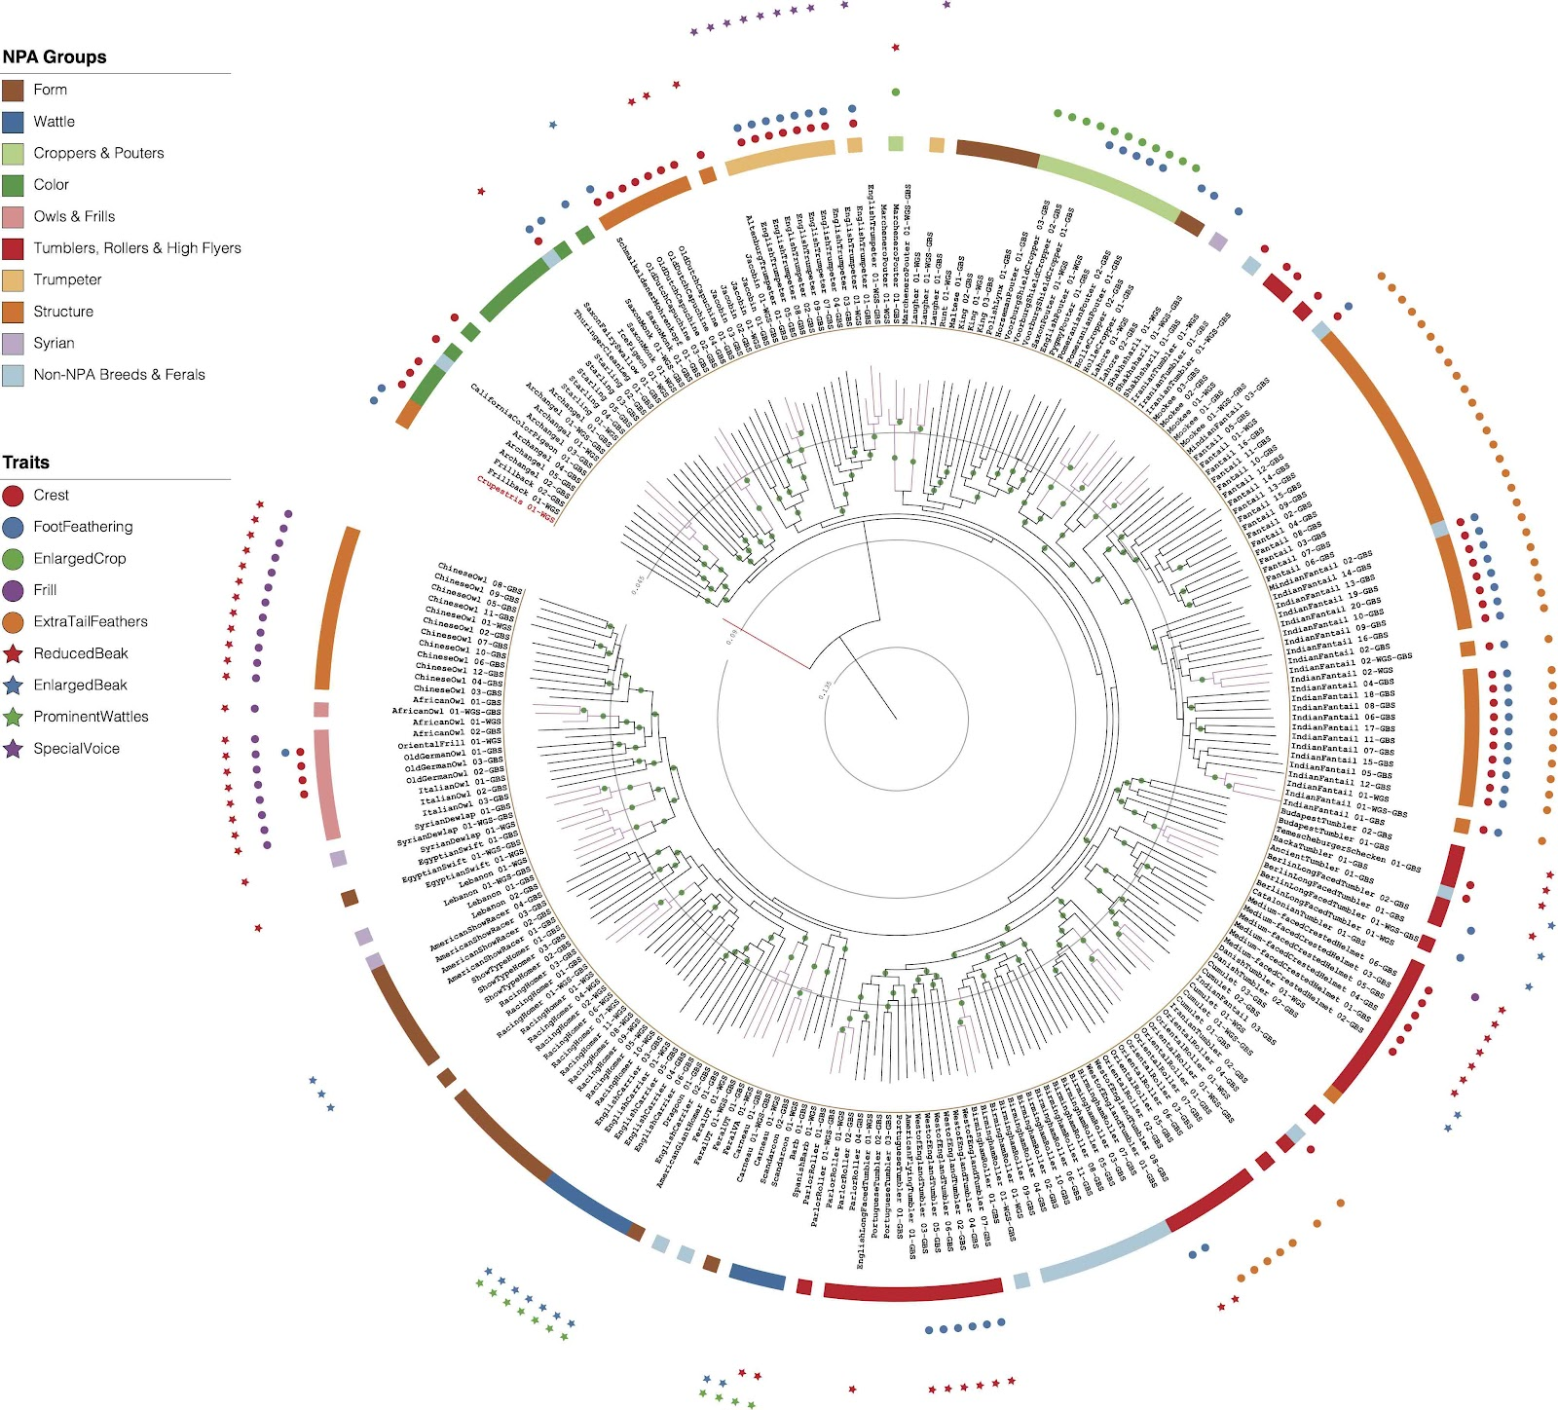
Specialised Education | Genomics of Pigeons

Slide 18
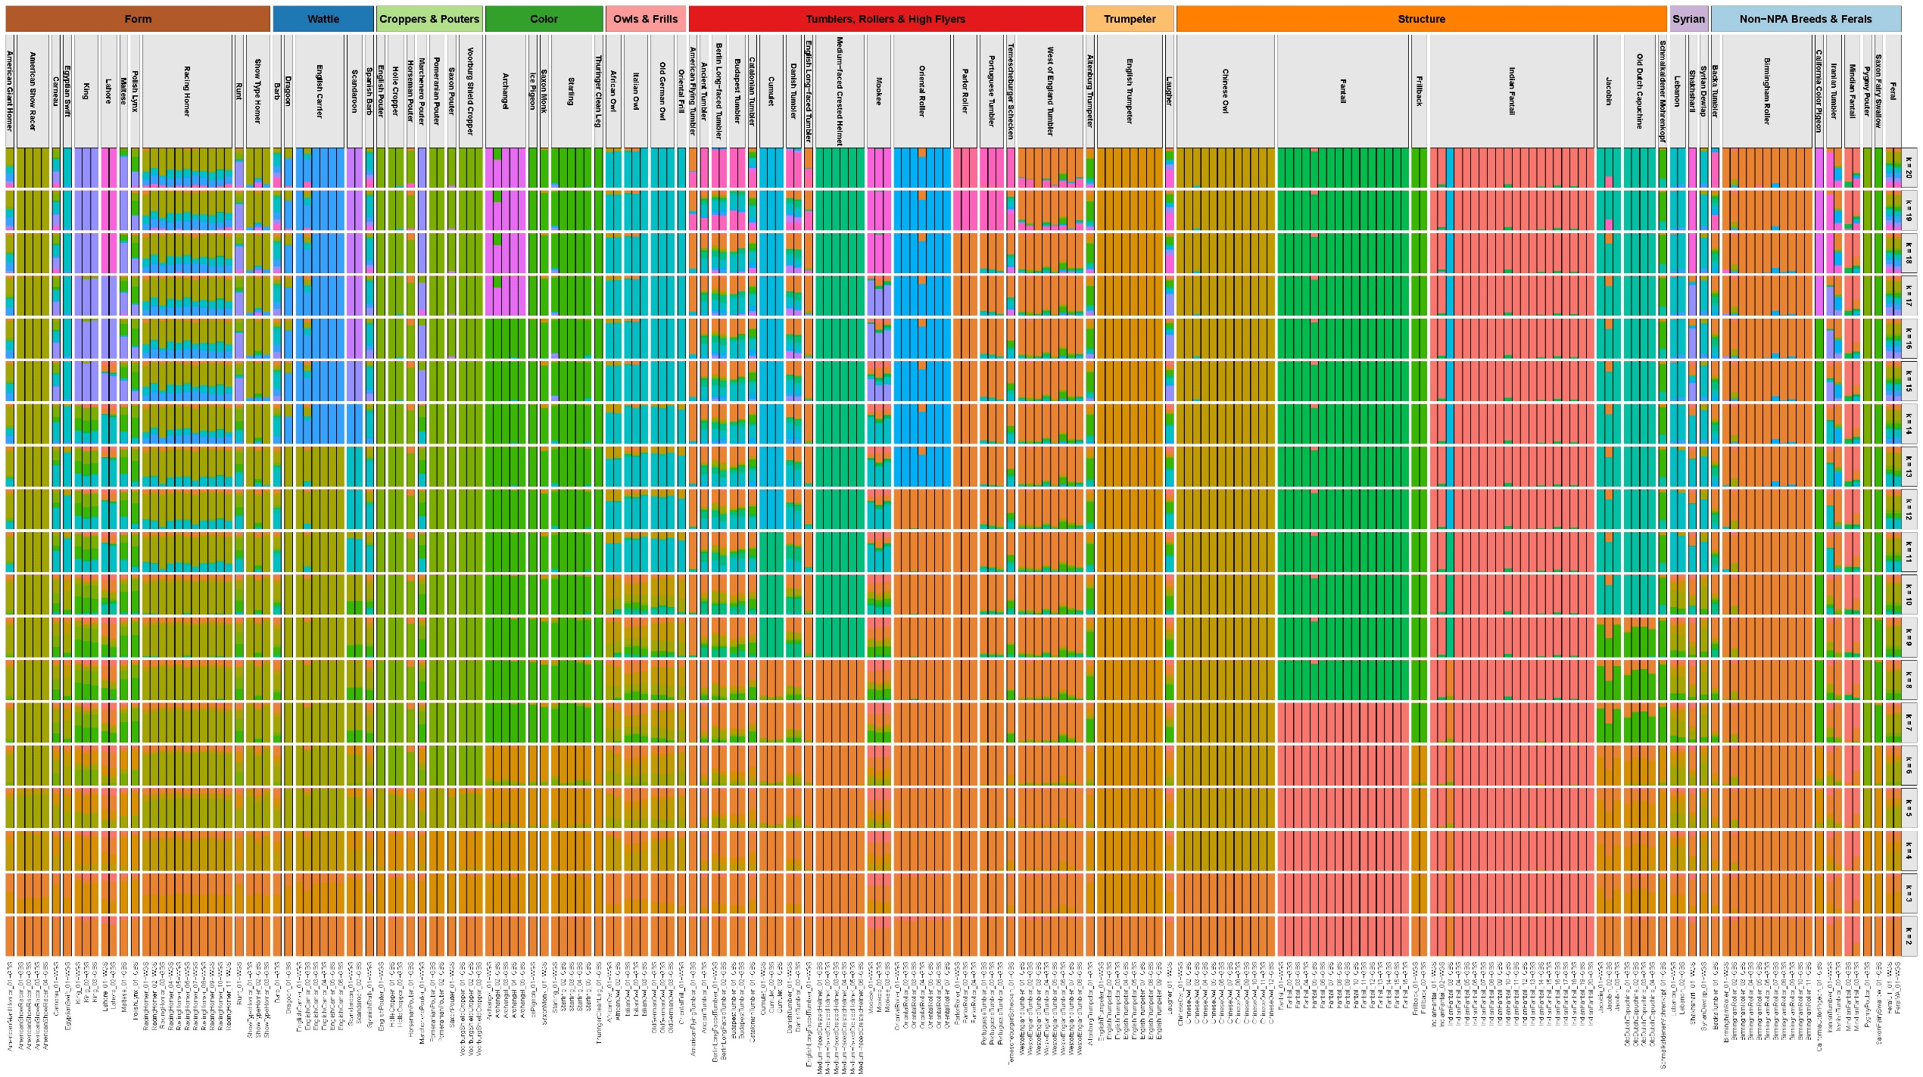
Specialised Education | Genomics of Pigeons

Slide 19
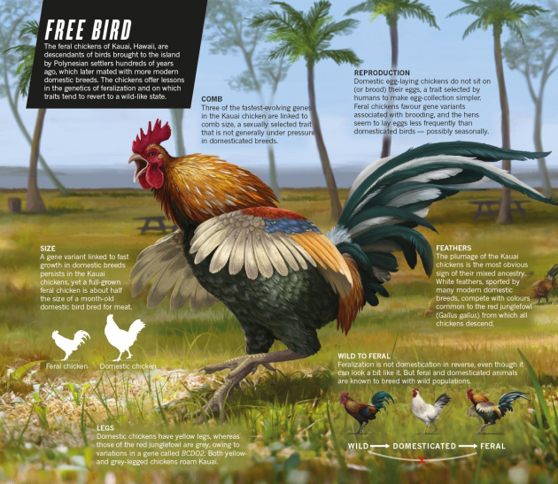
Specialised Education | Genomics of Pigeons
When Chickens Go Wild
Nature | Vol. 529:270-273
Ewen Callaway
Simply the Reverse of Domestication?
E.g. Dogs, Horses, Pigs, Cats (...)

Slide 20
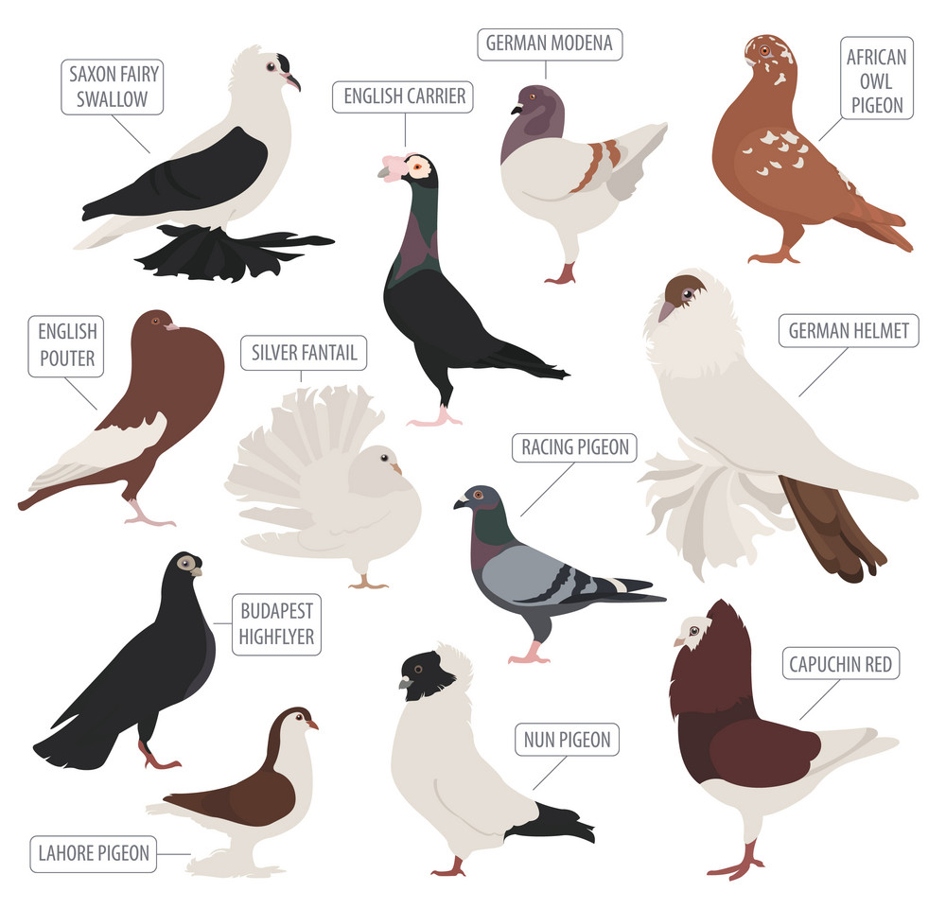
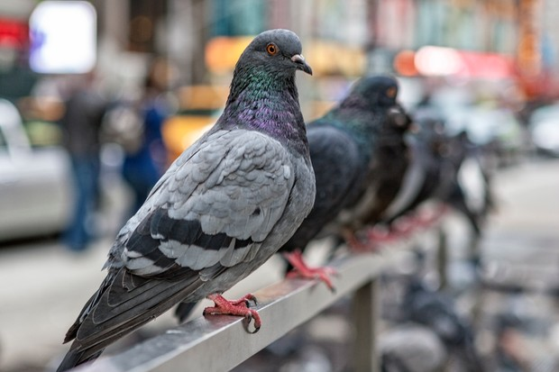
Specialised Education | Genomics of Pigeons
Feral Pigeon Populations?

Slide 21
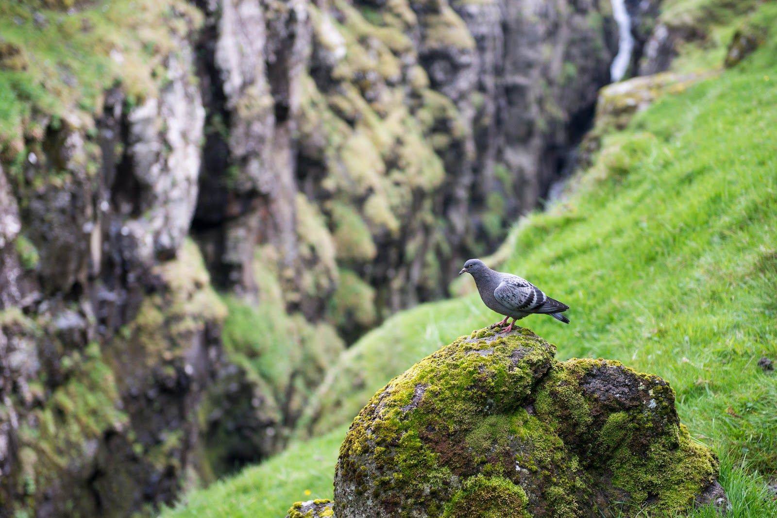
Specialised Education | Genomics of Pigeons
¿ Is there any wild rock dove colony left?
Rock Dove on the Faroe Islands: wild or not?
+700 samples
Covering All Continents
+30 Collaborators

Slide 22
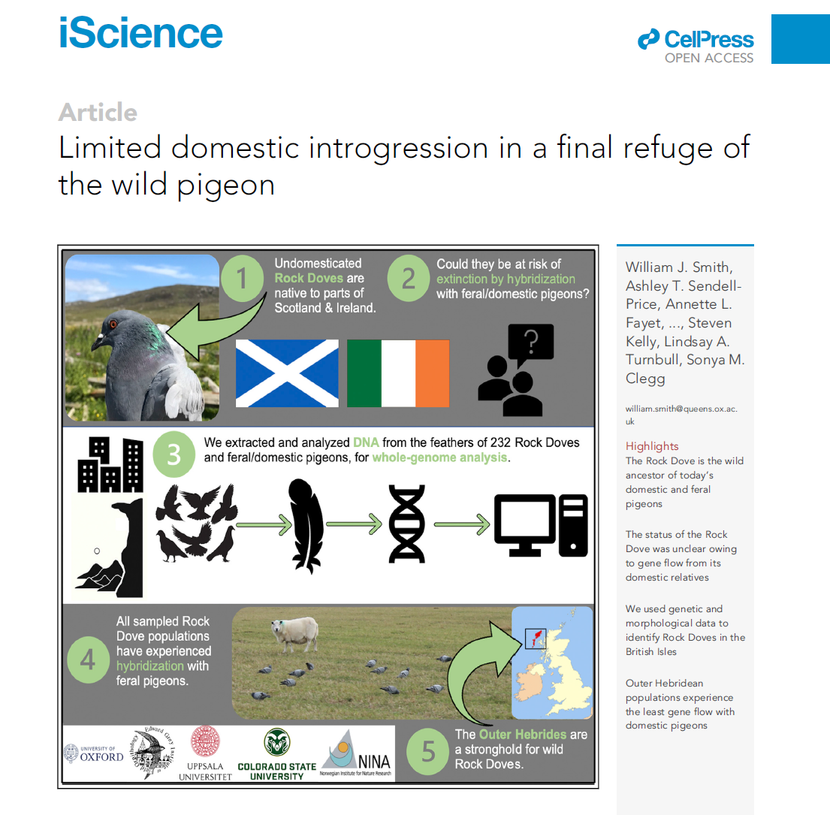
Specialised Education | Genomics of Pigeons

Slide 23
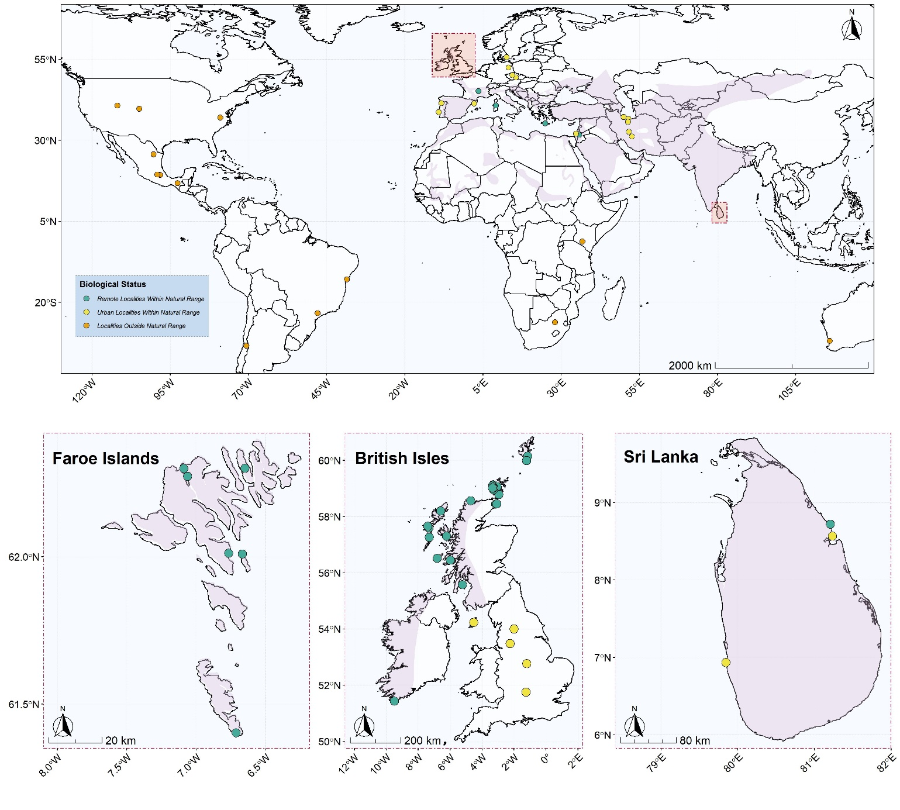
Specialised Education | Genomics of Pigeons

Slide 24
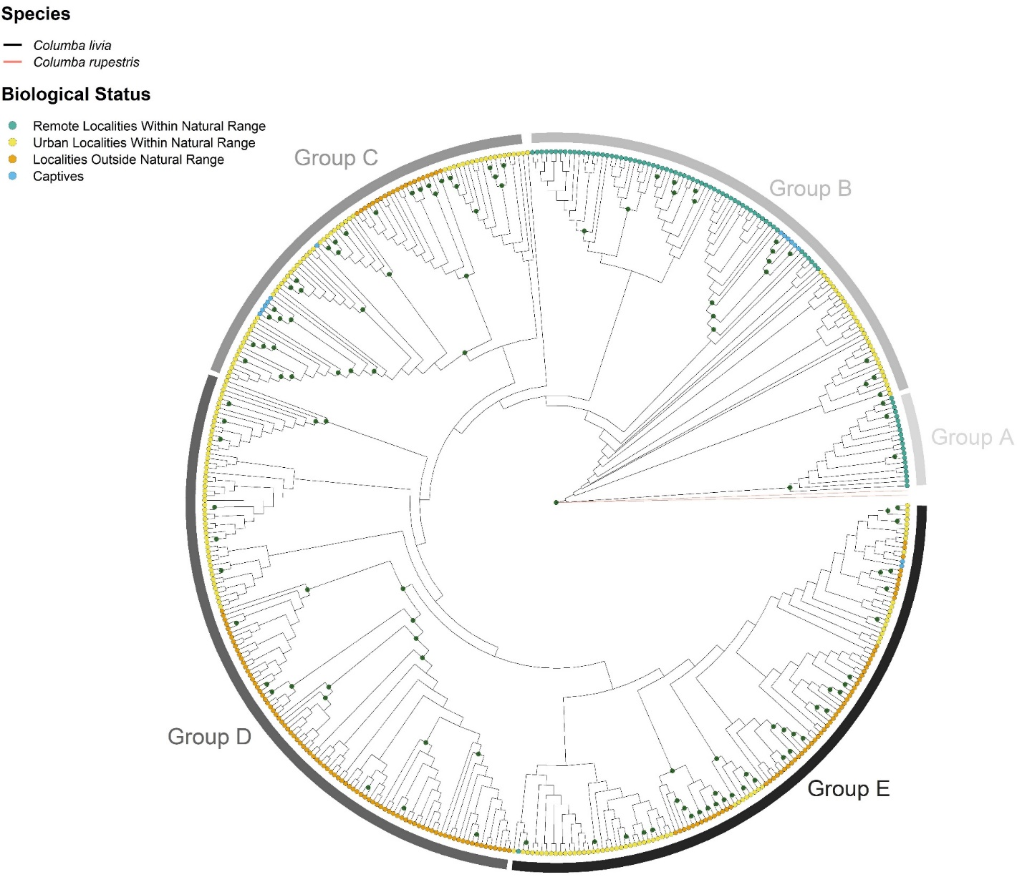

Specialised Education | Genomics of Pigeons
Pigeon Island National Park, Sri Lanka

Slide 25
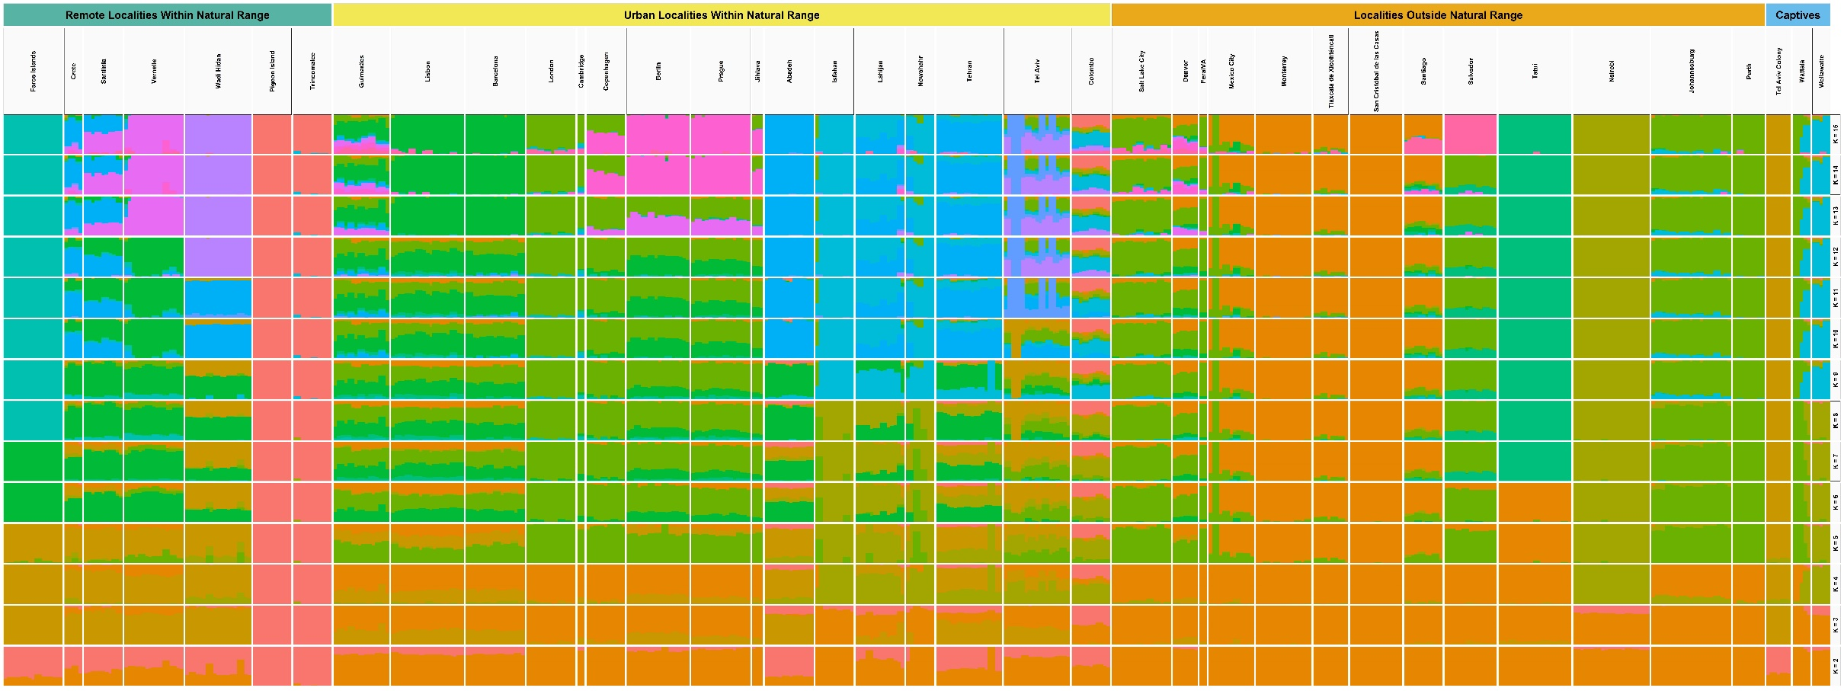

Slide 26
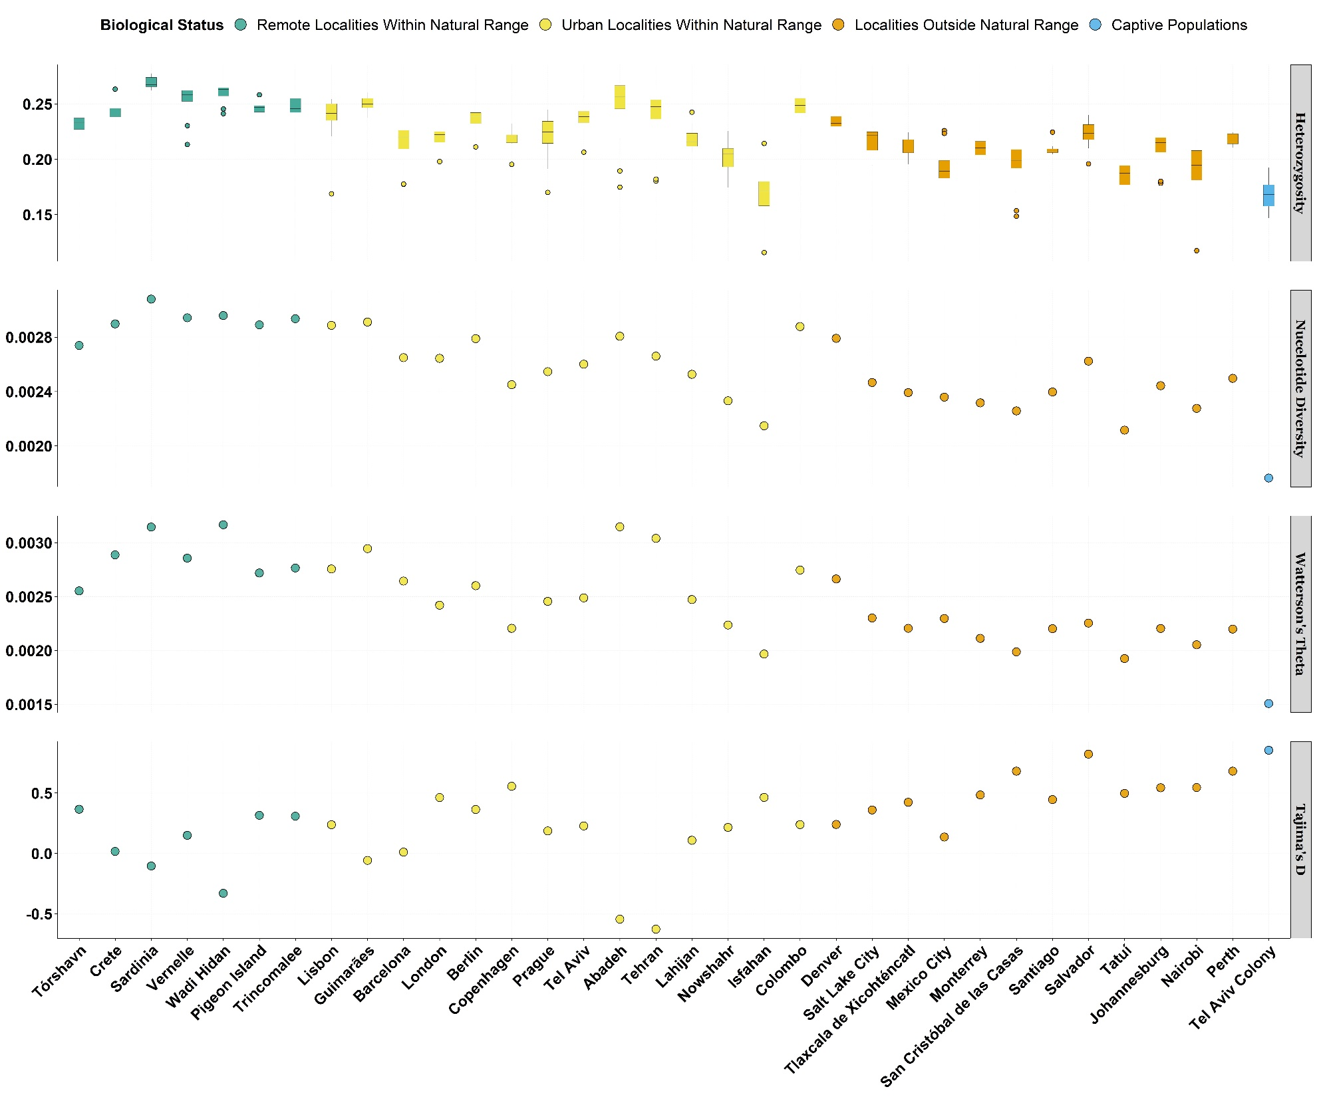

Slide 27
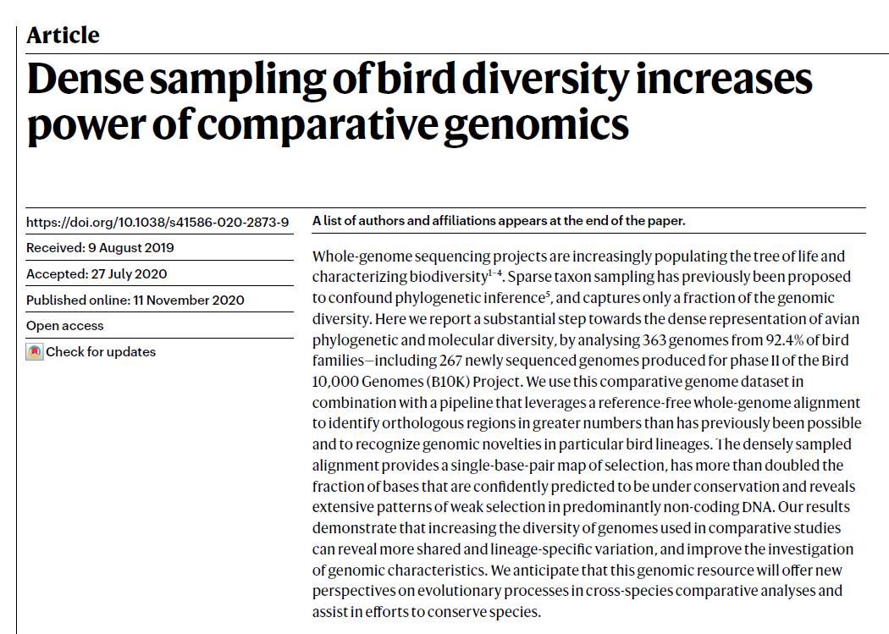
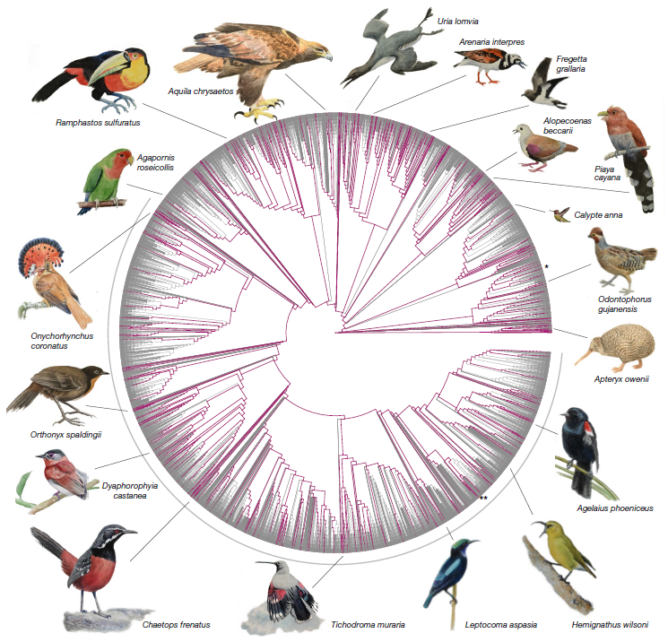
Parallel Collaborations | Bird 10K Project

Slide 28
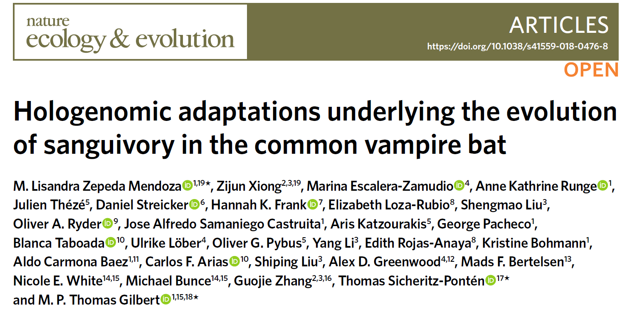
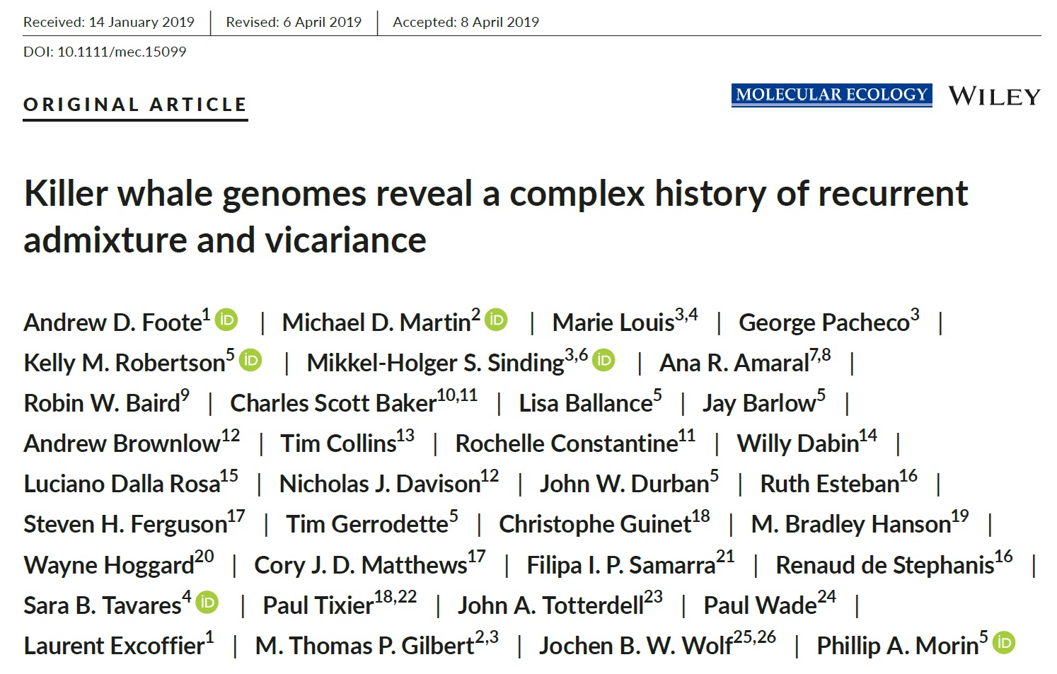
Parallel Collaborations | Other Projects

Slide 29
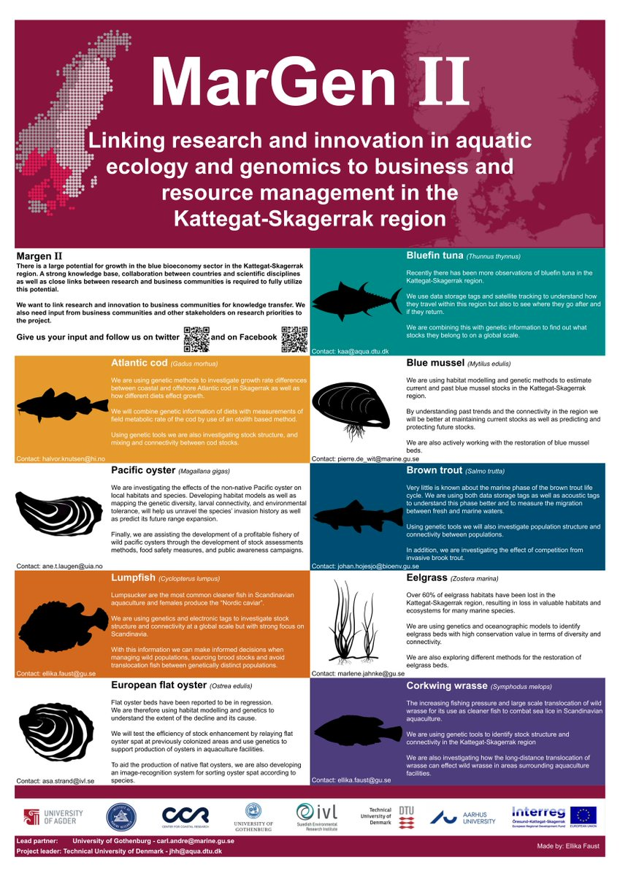
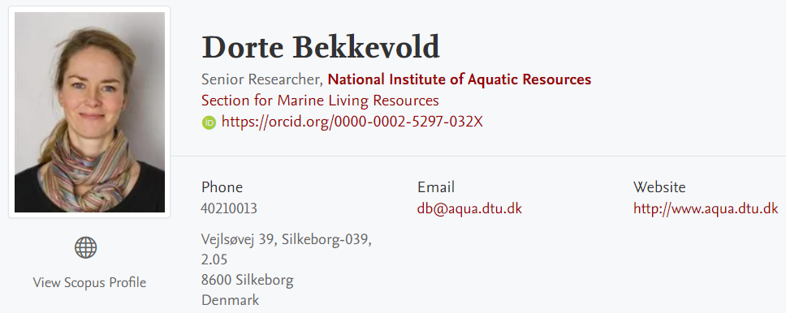
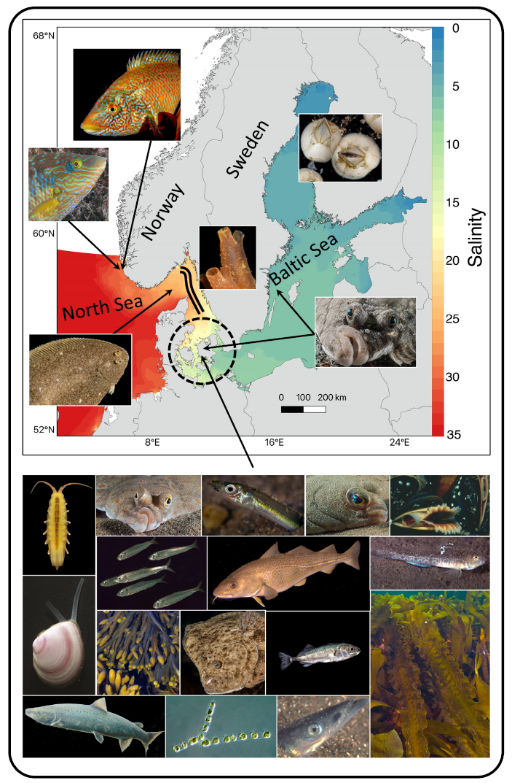
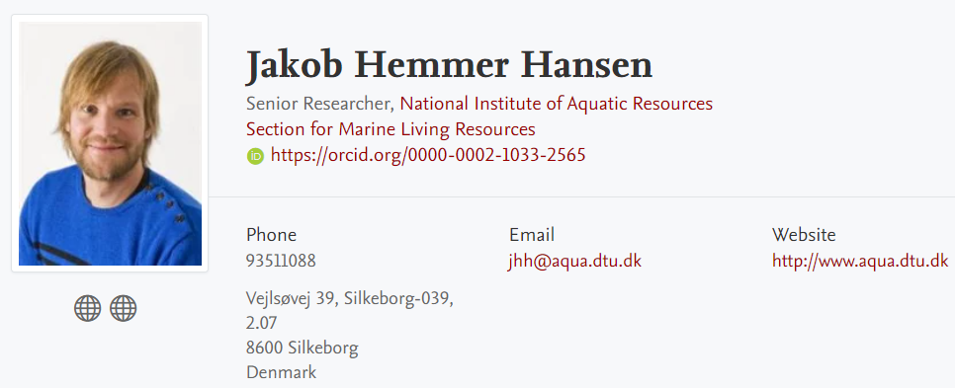
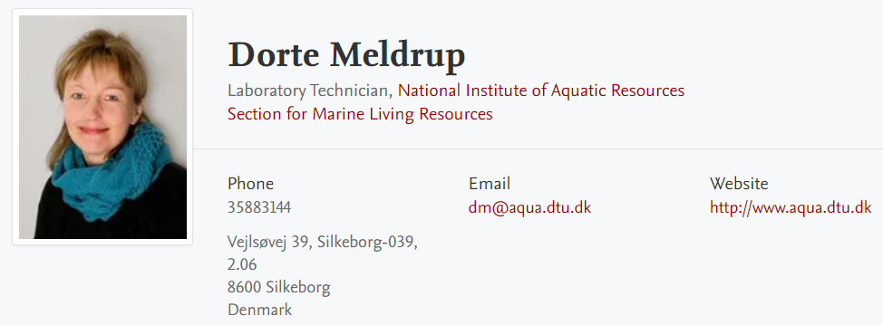
Past Post-doc

Slide 30
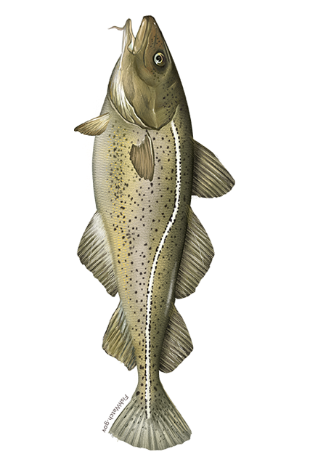
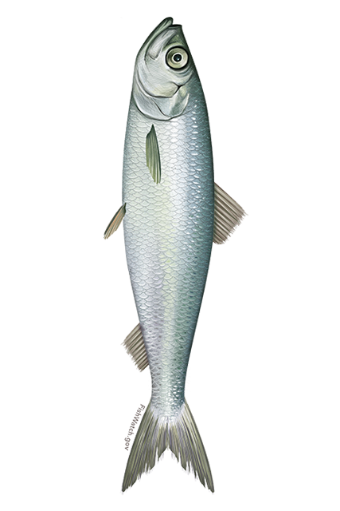
Past Post-doc
WGS / Extreme Populations
Atlantic Cod (Gadidae)
Atlantic Herring (Clupeidae)
European Flounder (Pleuronectidae)
Turbot (Scophthalmidae)
Lumpfish (Cyclopteridae)

Slide 31
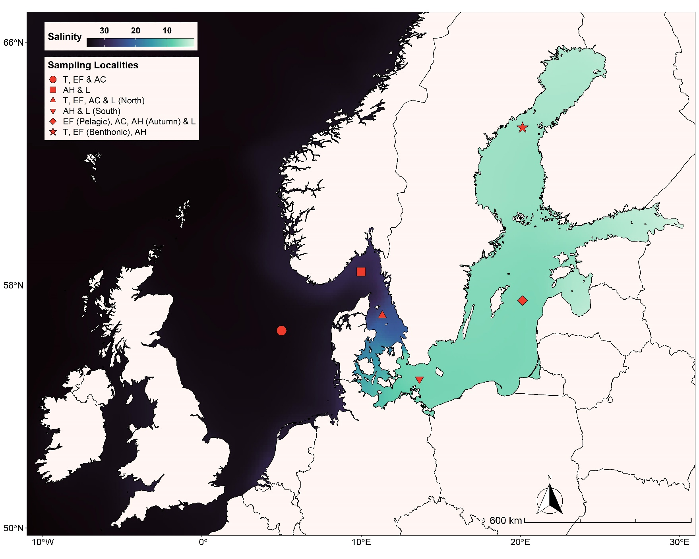
Past Project

Slide 32
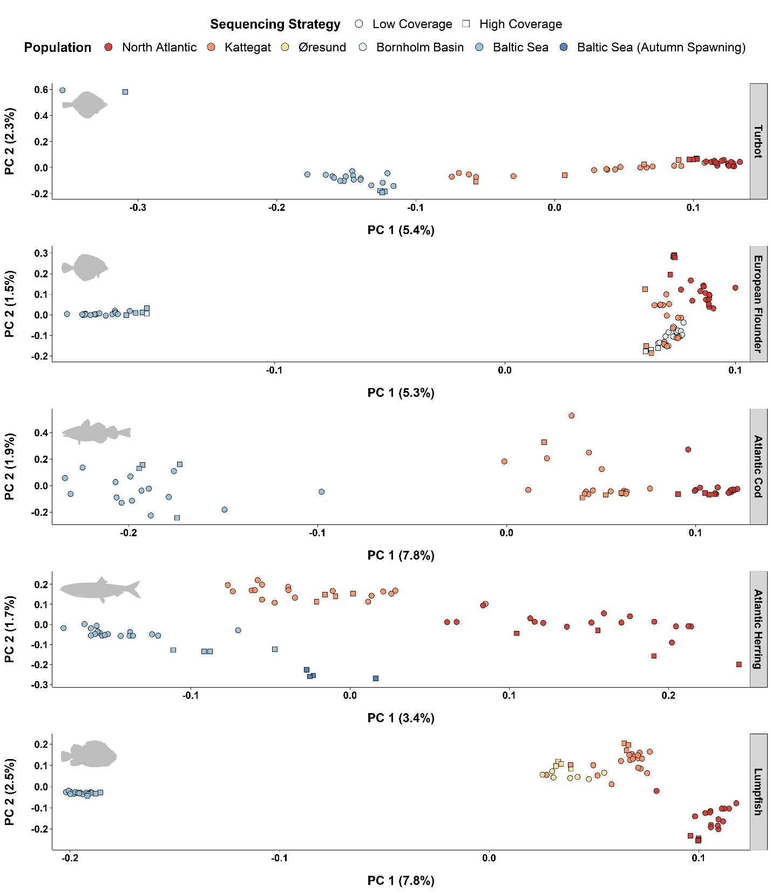

Slide 33
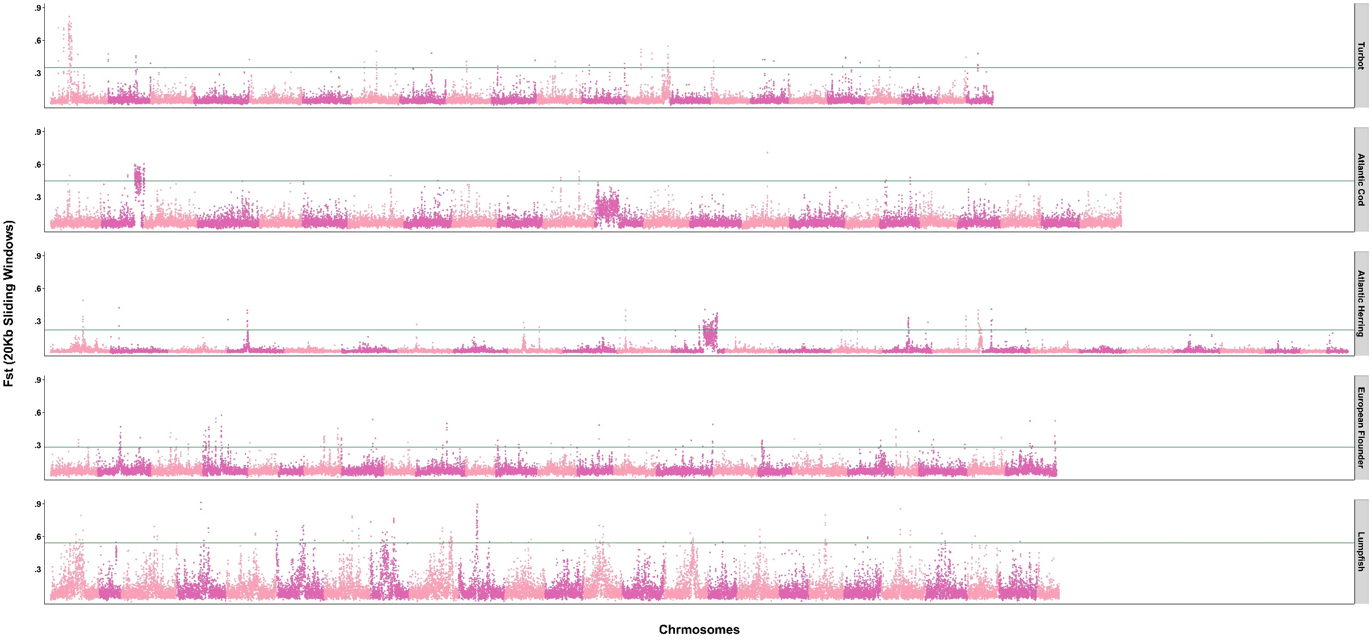

Slide 34
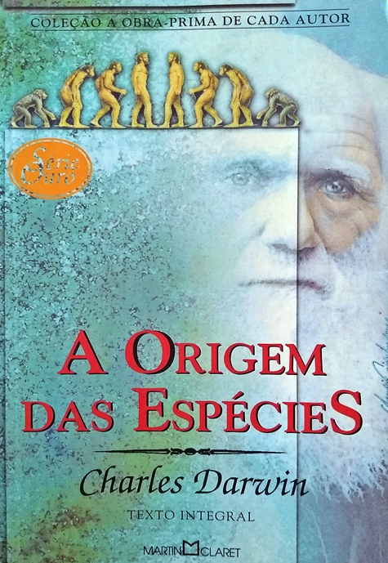
Future Perspectives

Slide 35

Future Perspectives

Slide 36

Future Perspectives

Slide 37

Future Perspectives

Slide 38

Future Perspectives

Slide 39



Future Perspectives
(…) Perhaps there is a genetic component (…)

Slide 40

Future Perspectives

Slide 41

Future Perspectives

Slide 42


